Slide 1
Introduction to C
Lecture: 1, 2, 3, 4, 5
Reference: Chapter 1.1-1.6, 1.10
Date: 07.07.2014, 08.07.2014, 15.07.2014, 16.07.2014, 11.08.2014
Prepared by:
Johra Muhammad Moosa
Lecturer
Department of Computer Science & Engineering
Bangladesh University of Engineering & Technology

Slide 2
About C
Invented and first implemented by Dennis Ritchie
Middle level language
Structured and disciplined approach to computer program
ANSI (American National Standards Institute) approved a standard in 1989

Slide 3
Why you need C?
To communicate with a machine/computer
Robotics
microcontrollers: automobiles and airplanes
Embedded processors: phones, portable electronics, etc.
DSP (Digital Signal Processing) processors: digital audio and TV systems

Slide 4
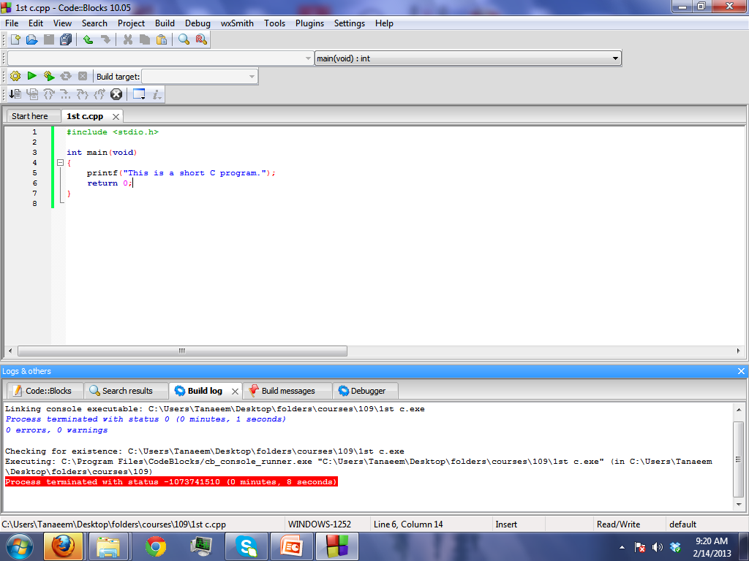
A first look at C
header file
return type
function
start of program
statement
parameter
end of program
Library function

Slide 5
A first look at C
# include <stdio.h>
int main(void)
{
printf(“This is a short C program”);
return 0;
}
# include
# symbol indicates a preprocessor
It means it has to be done before compilation
  #include to include the contents of the header file

Slide 6
A first look at C
# include <stdio.h>
int main(void)
{
printf(“This is a short C program”);
return 0;
}
<stdio.h>
Name of the header file
Header files: constants, functions, other declarations
You must know which header you need
Use help and documentation to find out

Slide 7
A first look at C
# include <stdio.h>
int main(void)
{
printf(“This is a short C program”);
return 0;
}
<stdio.h>
Enclosed in < > (header in default place)
May be enclosed in “ ” (header is in the same folder as the source)
stdio.h : standard input/output header file
  Needed for the function: printf()
Notes:
math.h, string.h, stdlib.h etc

Slide 8
A first look at C
# include <stdio.h>
int main(void)
{
printf(“This is a short C program”);
return 0;
}
main
Every C program must have a ‘main’ function
Program starts from the 1st line in ‘main’
  Parameter type void
  Return type int
  int main()

Slide 9
A first look at C
# include <stdio.h>
int main(void)
{
printf(“This is a short C program”);
return 0;
}
{ } curly braces
The curly braces are like containers
The code between two braces are called a block
Missing either brace will generate compile error
  “Compound Statement missing”

Slide 10
A first look at C
# include <stdio.h>
int main(void)
{
printf(“This is a short C program”);
return 0;
}
{ } curly braces
Left curly brace {
  Begin the body of function
Right Curly brace }
  End of the function

Slide 11
A first look at C
# include <stdio.h>
int main(void)
{
printf(“This is a short C program”);
return 0;
}
printf
A function given in stdio.h
Prints the text given as the parameter

Slide 12
A first look at C
# include <stdio.h>
int main(void)
{
printf(“This is a short C program”);
return 0;
}
; (semicolon)
Every C statement must end with a ;
Otherwise compiler will generate an error
  Statement Missing

Slide 13
A first look at C
# include <stdio.h>
int main(void)
{
printf(“This is a short C program”);
return 0;
}
return 0
Indicate how the program exited
  return 0 means that execution was successful and there was no error.
  abnormal termination is usually signaled by a non-zero return
  but there is no standard for how non-zero codes are interpreted.
When a program is called by another program

Slide 14
Basic Structure of a C Program
Function
  Building Block
  Named subroutine
    Can be called by other parts of the program
  May contain more than one functions
  One of which must be main()
    Where execution begins
  Standard library
    Provides library functions
    Example: I/O operation, string, math … etc

Slide 15
Basic Structure of a C Program
Header file
  .h extension
  Add header file using #include (preprocessor directive)
Statement
  Action performed by the program
  Perform operations
  End with a semicolon (;)
  Two or more statements can be placed on a single line
Case sensitive
  Main & main are different
Indentation
  Not a programming decision

Slide 16
Programming Tools
Compiler
Standard Library
IDE
Help files & documentations

Slide 17
Compilers
What does it do?
  Parse the code
  Tokenize
  Match syntax
  Find Errors
  Prepare object code

Slide 18
Standard Library
What does it do?
  Provide implementations of some basic and important functions
  Usually these functions are very efficient
  Programmers should use library functions to improve performance and portability

Slide 19
IDE - Integrated Development Environment
Helps to Write
  Use different color to highlight different type of code
  Sometimes shows hints
Helps to Compile
  Set environment variables
  Linking with libraries

Slide 20
IDE - Integrated Development Environment
Helps to Debug
  Execute step by step
  Use breaks
  Watch the values of variables
Helps to Run

Slide 21
Help Files and Documentation
Provide details about
  Syntax
  Keywords
  Library functions
  Examples
  Etc.

Slide 22
Lifecycle of a C Program
User defined
Header File
Standard
Header File
Source
File
Compile
Compile
Compile
Link
Library File
Object File
Executable
File

Slide 23
Keywords
C has some words that has a special meaning for the compiler
These words can not be used to name variables, functions etc.
auto | double | int | struct
break | else | long | switch
case | enum | register | typedef
char | extern | return | union
const | float | short | unsigned
continue | for | signed | void
default | goto | sizeof | volatile
do | if | static | while

Slide 24
Variables
Variables are placeholders
  They can hold values
Global variables
  Outside all function
  Can be accessed by any function
Local variables/ automatic variables
  Inside a block/function
The values can be assigned, changed, read etc.
Each variable takes up some memory space
Variables must be defined before using them

Slide 25
Variable Declaration
First write the keyword for datatype
Then write the name of the variable
Example
  int num=10;
  char c=‘a’;
  int i, j, k;
  char esc=‘\\’;
  float exp=3.2e-5;

Slide 26
Variables
Name of variable
  Case sensitive
    Count, count & COUNT are different
  Can be of any length, but only first 31 characters are important
  Can contain letters, digits and the ‘_’
  But first character must be a letter or ‘_’
  Variable name cannot be same as a keyword
  For example –
  correct: abcd, abcd2, abcd_3, Abcd
  incorrect: ab cd, 2abcd, abcd…3, ab!cd

Slide 27
Variables
Name of variable
  Should be clear and meaningful
  If two or more words are needed then either separate them using a ‘_’ or keep them together, but start each word except the first one with a capital
  For Example –
  student_no average_age
  dateOfBirth averageAge
  Second way is recommended

Slide 28
Datatype
C has basically these data types-
  int (integer / whole number)
  float (floating point / fraction)
  double (double precision float)
  char (character)
  void (empty / no value )
  enum (enumeration)

Slide 29
Datatype
Modifiers
  long
  short
  unsigned
  signed
  Except type void, the basic data types may have various modifiers preceding them.
Qualifiers
  const
    may not be changed by your program.
    can be given an initial value, however.
    compiler is free to place variables of this type into read-only memory (ROM).
  volatile
Notes:
Int: all 4
Char: signed, unsigned
Double: long

Slide 30
Datatype
Example
  int
  long int
  unsigned long int
  const unsigned long int

Slide 31
Datatypes
Datatype Size Range
unsigned char 8 bits 0 to 255
char 8 bits -128 to 127
enum 16 bits -32,768 to 32,767
unsigned int 16 bits 0 to 65,535
short int 16 bits -32,768 to 32,767
int 16 bits -32,768 to 32,767
unsigned long 32 bits 0 to 4,294,967,295
long 32 bits -2,147,483,648 to 2,147,483,647
float 32 bits 3.4 * (10**-38) to 3.4 * (10**+38)
double 64 bits 1.7 * (10**-308) to 1.7 * (10**+308)
long double 80 bits 3.4 * (10**-4932) to 1.1 * (10**+4932)

Slide 32
Float vs. Double
Single precision (float) gives you 23 bits of significant, 8 bits of exponent, and 1 sign bit.
Double precision (double) gives you 52 bits of significant, 11 bits of exponent, and 1 sign bit.

Slide 33
Printing Variables
#include <stdio.h>
int main(void)
{
int num=10;
printf("num=%d", num);
return 0;
}

Slide 34
Conversion Specifiers
Integer: %d
Character : %c
Float : %f
Double : %f

Slide 35
Input numbers from keyboard
#include <stdio.h>
int main(void)
{
int num;
scanf("%d", &num);
printf("num=%d", num);
return 0;
}
& (ampersand) : ADDRESS OPERATOR

Slide 36
Input multiple numbers from keyboard
#include <stdio.h>
int main(void)
{
int num1, num2;
scanf("%d %d", &num1, &num2);
printf("num=%d", num1+num2);
return 0;
}
Input must be seperated by blank, tab or newline
Common programming error:
  Forgetting address operator (&) before variable name in scanf
  Placing commas (when none are needed) between conversion specifiers

Slide 37
Expressions
Combination of operators and operands
Appear on the right side of an assignment statement

Slide 38
Operators
Depending on the number of operand, operators can be-
  Unary (-a)
  Binary (a-b)
  Ternary (later)
Depending on the functionality, operators can be-
  Arithmetic
  Bitwise
  Assignment
  Relational
  Logical
  Others
Operators containing two symbols can not be separated by space.

Slide 39
Arithmetic operators
‘+’ plus binary
‘-’ minus binary
‘*’ multiply binary
‘/’ division binary
‘%’ modulus binary, int only
‘++’ increment unary
‘--’ decrement unary
‘-’ unary negation unary (one operator)

Slide 40
Increment and Decrement Operator
Postfix operator
  n++, n--
Prefix operator
  ++n, --n

Slide 41
Example
count=count*num+88/val-19%count;
char x,y;
x=‘a’;
y=‘b’;
int z=x+y;

Slide 42
Bitwise Operators
These operators are used for bitwise logic operations.
The operands must be integer values
‘&’ bitwise AND binary
‘^’ bitwise XOR binary
‘|’ bitwise OR binary
‘~’ 1’s complement unary
‘!’ bitwise NOT unary
‘<<’ left shift binary
‘>>’ right shift binary

Slide 43
Assignment Operators
These operators assign the value of the expression on the right to the variable on the left
‘=’ assign binary
Shortcuts
  a += b; means a = a + b;
‘+=’, ‘- =’, ‘*=’, ‘/=’, ‘%=’,
‘&=’, ‘|=’, ‘^=’, ‘<<=’, ‘>>=’

Slide 44
Relational Operators
These operators are used for comparison. The result is boolean.
‘<’ less than binary
‘>’ greater than binary
‘<=’ less/equal binary
‘>=’ greater/equal binary
‘==’ equal binary
‘!=’ not equal unary

Slide 45
Logical Operators
These operators are evaluating logical expressions.
The result is boolean
‘&&’ logical AND binary
‘||’ logical OR binary
‘!’ logical NOT unary

Slide 46
Operator Precedence
If there are a chain of operations, then C defines which of them will be applied first.
*, / and % are higher in precedence that + and -
Precedence can be altered by using parentheses
  Innermost parentheses evaluated first
For example-
  6+4/2 is 8
  because ‘/’ has precedence over ‘+’
  if we want the ‘+’ to work first, we should write-
  (6+4)/2

Slide 47
Precedence Chart
! ~ ++ -- + -
* / %
+ -
<< >>
< <= > >=
== !=
&
^
|
&&
||
= += -= *= /= %= &= |= ^=

Slide 48
Example
Stepwise evaluation of the expression x=7/6*4+3/5+3
  x=7/6*4+3/8+3
  x=1*4+3/5+3 operation: /
  x=4+3/5+3 operation: *
  x=4+0+3 operation: /
  x=4+3 operation: +
  x=7 operation: +
All the operators associate from left to right except for assignment operators

Slide 49
Example
  Determining difference between two persons’ height
#include<stdio.h>
int main ()
{
  int f1, i1, f2, i2, f3, i3, d;
  printf("Enter height (feet,inches) of person one: ");
  scanf("%d,%d", &f1, &i1);
  printf("Enter height (feet,inches) of person two: ");
  scanf("%d,%d", &f2, &i2);
  d=(f1*12+i1)-(f2*12+i2);
  f3=d/12;
  i3=d%12;
  printf("Difference between height is %d feet, %d inches\n", f3, i3);
  return 0;
}

Slide 50
Comments
Note for the programmer
Ignored by the compiler
Used as documentation
Can be used anywhere a space character (blank, tab/ newline) can.
Comment can be used to temporarily remove a chunk of codes.

Slide 51
Comments
Two types of comments
  Single line
    Starts with //
    Can not be spread over several lines
    Not currently defined by ANSI C
    Created by C++
    Use in C program is technically invalid
    Valid in C99
  Multiline
    Can not be nested
    Starts with /*
    Ends with */

Slide 52
Comments
Following program is valid
#include <stdio.h>
int main(void)
{
int num1, /*allowed! */num2;
scanf("%d %d", &num1, /*allowed too!*/&num2);
printf("num=%d", num1+num2);
return 0;
}

Slide 53
Return type before main
If not placed warning will be shown
'void' return type will be assumed

Slide 54
Home Work
Given the radius of a circle, write a C program to calculate it’s area.
Write a C program which convert temperature from Fahrenheit to Celsius.
Find the values of x & n after each statement of the following code segment:
    x=n++;
    x=++n;

Slide 55
Practice (chapter 1)
Examples & Exercise
  Of section 1.1-1.6, 1.10
Mastery Skill Check
  1-5
Review Skill Check
  1-8

Slide 56
Reference
TEACH YOURSELF C
  Herbert Schildt
Source code available in: http://www.osborne.com

